Slide 1
Numerical Solution of ODEs using Euler’s method
Course Instructor
Engr. Rahemeen
Rahemeen.bukc@bahria.edu.pk

Slide 2
Why numerical solutions?
For many of the differential equations we need to solve in the real world, there is no "nice" algebraic solution.
That is, we can't solve it using the techniques (separation of variables, integrable combinations, or using an integrating factor), or other similar means.
As a result, we need to resort to using numerical methods for solving such DEs.
The concept is similar to the numerical approaches we saw in an earlier integration chapter (Trapezoidal Rule, Simpson's Rule).
Even if we can solve some differential equations algebraically, the solutions may be quite complicated and so are not very useful.
In such cases, a numerical approach gives us a good approximate solution.

Slide 3
Ordinary Differential Equation
An Ordinary Differential Equation (ODE) is a mathematical equation that relates a function to its derivatives. In other words, it describes how a function changes with respect to an independent variable (such as time or space). ODEs are used to model a wide variety of real-world phenomena, such as population growth, the motion of objects, electrical circuits, and much more.
What is an ODE?
An ODE is an equation that involves an unknown function and its derivatives. It describes how the function's value changes as the independent variable changes.

Slide 4
Ordinary: It refers to the fact that the equation involves derivatives with respect to only one independent variable. If there were multiple independent variables (like time and space), the equation would be a partial differential equation (PDE).
Differential: The equation involves derivatives, which express rates of change. For example, the rate at which velocity changes is acceleration, which is the derivative of velocity with respect to time.
Equation: The relationship between the function (the dependent variable) and its derivatives.

Slide 5
Euler’s Method Basic Concept
Euler's method is based on the idea of approximating the solution of an ODE using a series of linear steps. At each step, we move forward from the current point to a new point, using the derivative (slope) at the current point to predict the next value.
The general form of an ODE is:
Dy/dt=f(t,y),y(t0)=y0
​Where:
y(t) is the unknown function we want to solve for.
f(t,y) is a given function describing the rate of change of y with respect to t.
t0 is the initial value of t.
y0 is the initial value of y at t0.

Slide 6


Euler’s Method
Euler’s method uses the readily available slope information to start from the point (x0, y0) then move from one point to the next along the polygon approximation of the graph of the particular differential equation to ultimately reach the terminal point, (xn, yn).
Euler's Method assumes our solution is written in the form of a Taylor Series.
That is, we'll have a function of the form:
This gives us a reasonably good approximation if we take plenty of terms, and if the value of h is reasonably small.
For Euler's Method, we just take the first 2 terms only.
For understanding (y1=yo + h.f(x,y))
The last term is just ℎ times our dy/dx​ expression, so we can write Euler's Method as follows:

Slide 7
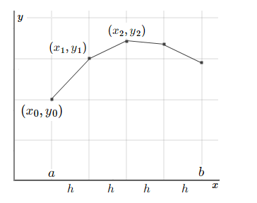
“Start at the known y value, then move one step h units to the right in the direction of the slope at that point, which is dy/dx =f (x,y). We will arrive at a good approximation to the curve's y-value at that new point."
We'll do this for each f the sub-points, h apart, from some starting value x=a to some finishing value, x=b, as shown in the graph below.

Slide 8
Applications of Euler's Method
Euler's Method has various applications in mathematics and science. Here are some of the most common applications:
Physics: Euler's Method can be used to solve differential equations in physics such as the motion of a projectile, the behavior of a simple pendulum, or the dynamics of a mass-spring system.
Engineering: Engineers can use Euler's Method to approximate the behavior of complex systems such as fluid dynamics, heat transfer, or electrical circuits.
Economics: Economists use Euler's Method to model the growth of economies, the evolution of stock prices, or the behavior of financial systems.
Robotics: Euler's Method is used in robotics to model the behavior of robotic systems, such as the motion of robot arms or the control of robot movements.
Finance: Financial analysts use Euler's Method to model the behavior of financial systems, such as stock prices or interest rates.

Slide 9

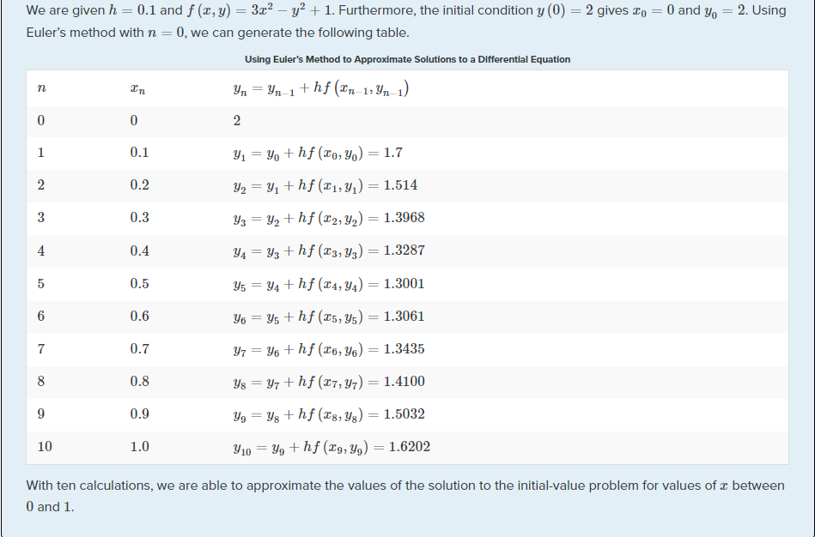
Example
Solution

Slide 10
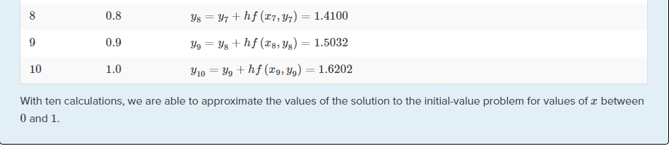

Slide 11
Modified Euler's Method
The Modified Euler method is a numerical technique for approximating the solutions of ordinary differential equations (ODEs).
It improves the simple Euler method, providing better accuracy by considering the average slope over a small interval.
By utilizing the average slope, this method substantially reduces errors. Moreover, it allows for iterative correction, progressively diminishing errors at each step, refining the value of y, and improving overall accuracy.
The predictor-corrector method is implemented in two steps:
The Predictor step typically employs a simple method like Euler's method to predict the next value of the solution:
𝒑𝒚 = 𝒚𝒏 + 𝒉 . 𝒇(x𝒏 , 𝒚𝒏 )
The Corrector step adjusts the prediction by using a weighted average of the predicted and actual derivatives to refine the solution:
𝒚𝒏+𝟏 = 𝒚𝒏 + 𝒉 𝟐 (𝒇(x𝒏 , 𝒚𝒏 ) + 𝒇(x𝒏+𝟏 ,𝒑𝒚))

Slide 12
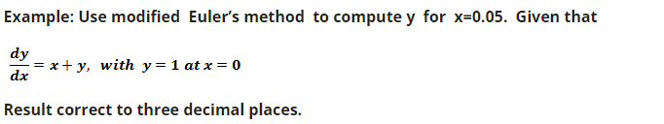
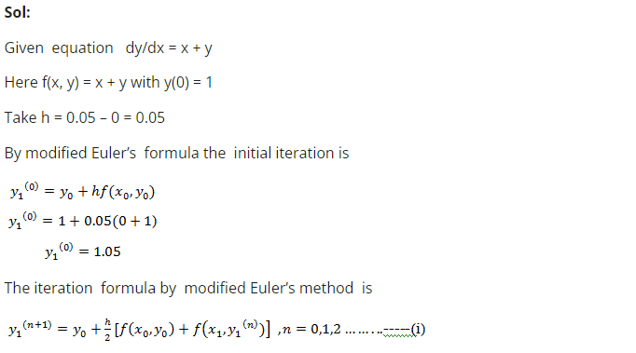
Example

Slide 13
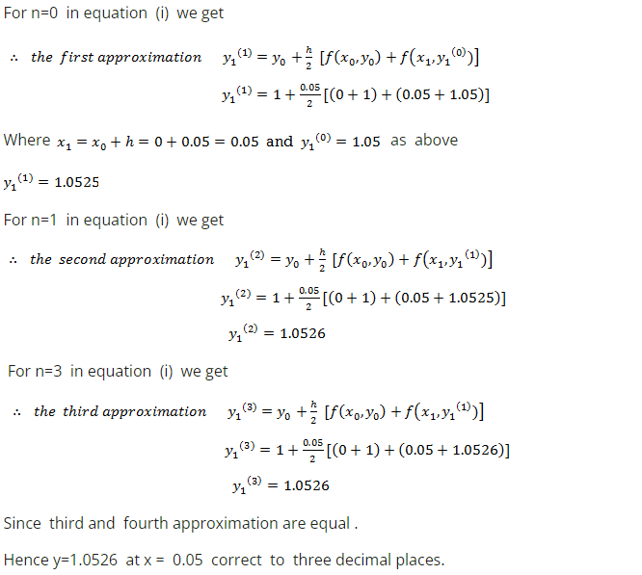

Slide 14
Exercises
Question # 01:
Approximate the solution of the initial value problem y′=2x+y, y(0)=1 using Euler's method with a step size of ℎ=0.1 over the interval [0,1].
Question # 02:
Approximate the solution of the initial value problem y′=−2y, y(0)=1 using Euler's method with a step size of ℎ=0.5 over the interval [0,2].
Question # 03:
Find y(0.2) for y′=x-y/2, y(0) = 1, with step length 0.1 using the Modified Euler method.

